Slide 1
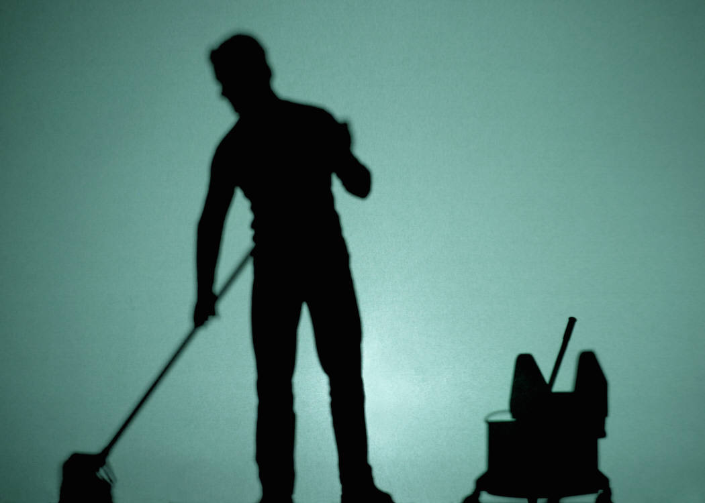
Causes of Accidents
Carelessness
Leaving spills on floors which may cause falls
Leaving obstructions on floors which may cause injury
Unsafe use of equipment
Negligence
Slippery wet or greasy floors
Improper lighting in the facility
Copyright © Notice: The materials are copyrighted © and trademarked ™ as the property of The Curriculum Center for Family and Consumer Sciences, Texas Tech University.

Slide 2
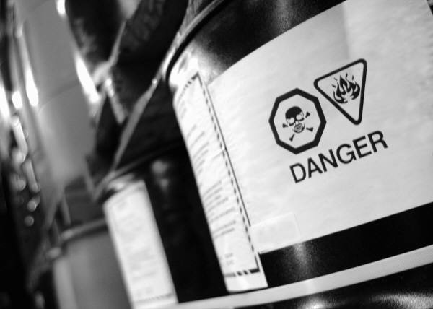
Causes of Accidents
Failure to follow standard policies and rules
Lighting gas stoves carelessly
Improper clothing near a flame
Flammable materials near a flame
Improper use of equipment
Dull knives
Frayed cords
Failure to read use manuals for equipment
Copyright © Notice: The materials are copyrighted © and trademarked ™ as the property of The Curriculum Center for Family and Consumer Sciences, Texas Tech University.

Slide 3
Causes of Accidents
Fatigue
Improper lifting
Carrying overly heavy loads
Working long hours
Improper sleep habits
Copyright © Notice: The materials are copyrighted © and trademarked ™ as the property of The Curriculum Center for Family and Consumer Sciences, Texas Tech University.

